Slide 1
CTE 2059 - Computer Graphic Lecture 1 – Scene & Primitives
University of Engineering and Technology
VIETNAM NATIONAL UNIVERSITY, HANOI

Slide 2
Outline
Getting Started
Installation
Creating a Scene
Fundamentals
Primitives
Box, Sphere, Cylinder, Torus, Cone, Capsule, Plane
Grouping & Hierarchy
Hands-On Activity

Slide 3
Getting Started

Slide 4
Installation
Installing VSCode: https://code.visualstudio.com/
Installing Node.js: https://nodejs.org/en/download (Window Installer)
Open VSCode, create a new folder, enable AutoSave option and open a Terminal
Check installation: Type these commands in the terminal
node --version => You should see a version number
npm --version => You should see a version number
Installing Three.js: Type these commands in the terminal
npm install --save three
npm install --save-dev vite
Installing VSCode Live Server Extension (Optional)

Slide 5
How to run the code?
Basic Structure:
At least one HTML file to define the webpage.
At least a JavaScript file to run your three.js code.
Static folder: resources such as textures, audio, 3D models will go here.
How to run the code: (using source code from three.js manual)
From your terminal, run: npx vite
From your html file, “Go Live” with Live Server Extension.
You should see a localhost URL linked to your web application
(It should be a page with a green cube in the middle and a dark background at this point).
Notes:
1. HTML File (Tệp HTML)
Đây đóng vai trò là "bộ khung" hoặc cái sân khấu để trình diễn.
Nhiệm vụ: Tạo ra một môi trường để trình duyệt web có thể hiển thị nội dung.
Thành phần quan trọng: Trong file này, bạn thường sẽ có một thẻ <canvas> (đây là nơi Three.js sẽ vẽ các hình ảnh 3D lên đó) hoặc chỉ đơn giản là một thẻ <div> để nhúng mã JavaScript vào.
Ví dụ: index.html.
2. JavaScript File (Tệp JavaScript)
Đây chính là "bộ não" và là nơi phép màu thực sự xảy ra.
Nhiệm vụ: Chứa toàn bộ logic của Three.js để điều khiển các đối tượng 3D.
Các thành phần bạn sẽ viết trong này:
Scene (Cảnh): Không gian 3D nơi mọi thứ tồn tại.
Camera: Góc nhìn của người dùng vào thế giới 3D.
Renderer (Trình kết xuất): Công cụ biến các dữ liệu toán học 3D thành hình ảnh pixel trên màn hình.
Animation Loop: Vòng lặp để tạo ra chuyển động.
Ví dụ: script.js hoặc main.js.
3. Static Folder (Thư mục tài nguyên tĩnh)
Hãy coi đây là "kho chứa đồ" của bạn.
Nhiệm vụ: Lưu trữ các tệp tin bên ngoài mà mã JavaScript cần gọi đến để làm cho thế giới 3D sinh động hơn.
Bên trong thường có:
Textures (Vân bề mặt): Các file ảnh (.jpg, .png) để dán lên bề mặt vật thể (ví dụ: hình ảnh mặt đất, vỏ Trái Đất).
3D Models: Các tệp mô hình được làm từ phần mềm khác như Blender (.gltf, .obj).
Audio: Âm thanh nền hoặc hiệu ứng tiếng động.
Lưu ý: Việc tách riêng thư mục này giúp quản lý dự án gọn gàng và tránh lỗi đường dẫn khi load tài nguyên.
Tóm tắt cách chúng phối hợp:
Trình duyệt mở file HTML.
File HTML gọi file JavaScript.
File JavaScript khởi tạo Three.js và tìm đến thư mục Static để lấy mô hình hoặc hình ảnh nhằm hiển thị lên màn hình.

Slide 6
Fundamentals

Slide 7
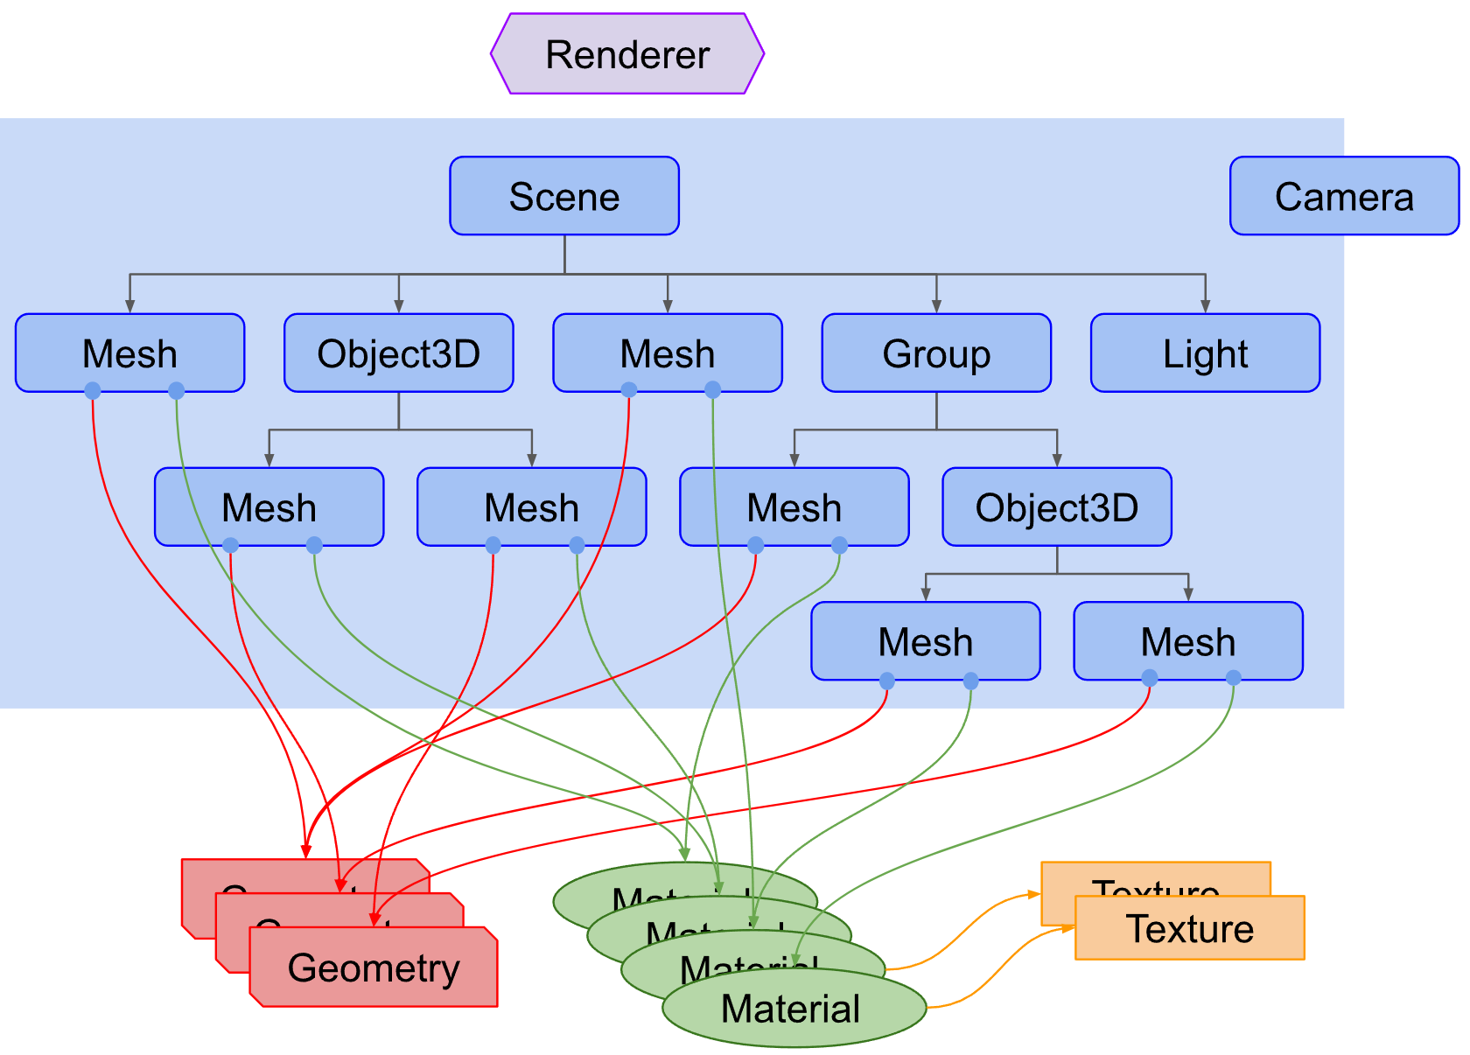
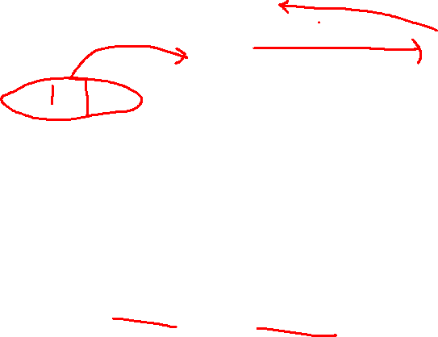
Structure of a Three.js app
Here is a diagram that represents a small three.js app:
Notes:
Things to notice about the diagram above:
There is a Renderer. This is arguably the main object of three.js. You pass a Scene and a Camera to a Renderer and it renders (draws) the portion of the 3D scene that is inside the frustum of the camera as a 2D image to a canvas.
There is a scenegraph which is a tree like structure, consisting of various objects like a Scene object, multiple Mesh objects, Light objects, Group, Object3D, and Camera objects. A Scene object defines the root of the scenegraph and contains properties like the background color and fog. These objects define a hierarchical parent/child tree like structure and represent where objects appear and how they are oriented. Children are positioned and oriented relative to their parent. For example the wheels on a car might be children of the car so that moving and orienting the car's object automatically moves the wheels. You can read more about this in the article on scenegraphs.
Note in the diagram Camera is half in half out of the scenegraph. This is to represent that in three.js, unlike the other objects, a Camera does not have to be in the scenegraph to function. Just like other objects, a Camera, as a child of some other object, will move and orient relative to its parent object. There is an example of putting multiple Camera objects in a scenegraph at the end of the article on scenegraphs.
Mesh objects represent drawing a specific Geometry with a specific Material. Both Material objects and Geometry objects can be used by multiple Mesh objects. For example to draw two blue cubes in different locations we could need two Mesh objects to represent the position and orientation of each cube. We would only need one Geometry to hold the vertex data for a cube and we would only need one Material to specify the color blue. Both Mesh objects could reference the same Geometry object and the same Material object.
Geometry objects represent the vertex data of some piece of geometry like a sphere, cube, plane, dog, cat, human, tree, building, etc... Three.js provides many kinds of built in geometry primitives. You can also create custom geometry as well as load geometry from files.
Material objects represent the surface properties used to draw geometry including things like the color to use and how shiny it is. A Material can also reference one or more Texture objects which can be used, for example, to wrap an image onto the surface of a geometry.
Texture objects generally represent images either loaded from image files, generated from a canvas or rendered from another scene.
Light objects represent different kinds of lights.

Slide 8
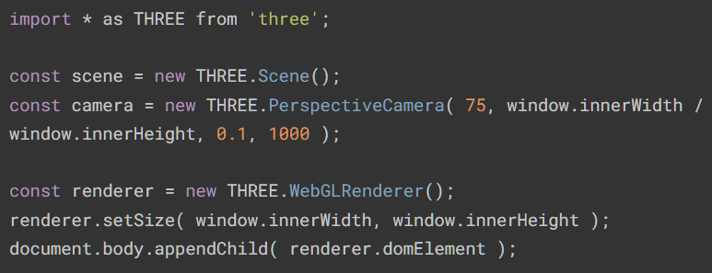
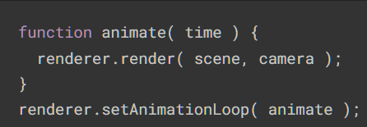
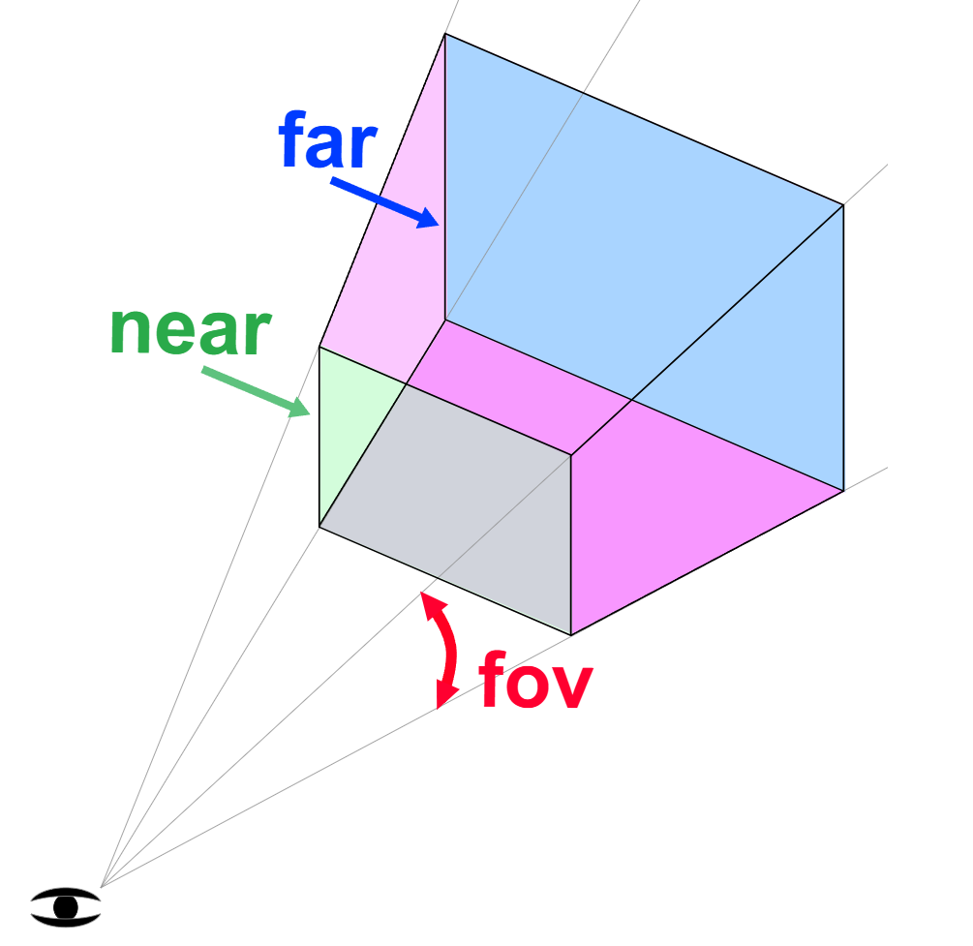
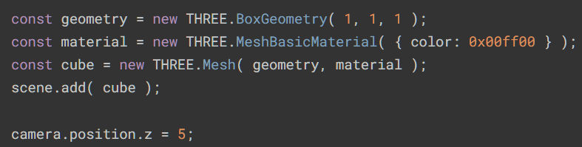
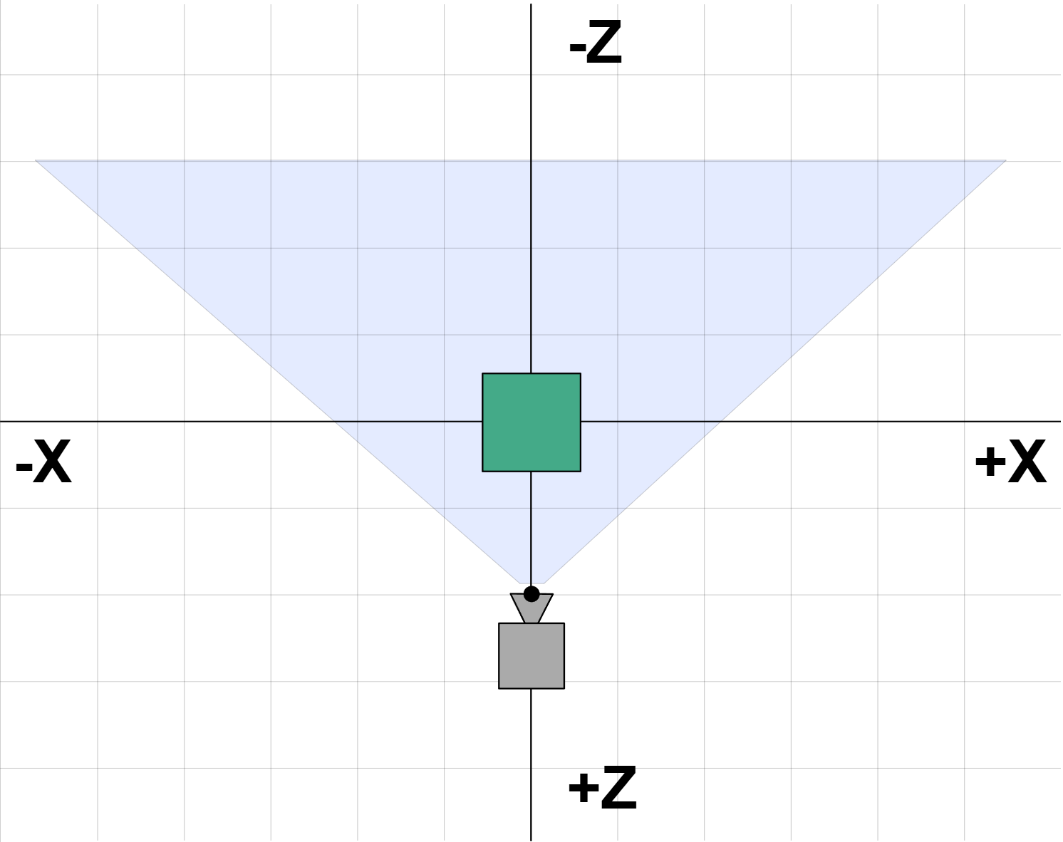

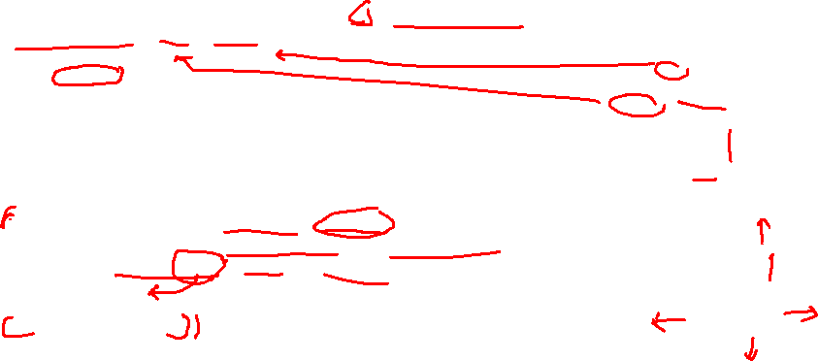
“Hello Cube” Setup
Creating the scene:
Rendering:
Adding a cube:
Notes:
// Creating scene
There are a few different cameras in three.js. For now, let's use a PerspectiveCamera.
The first attribute is the field of view. FOV is the extent of the scene that is seen on the display at any given moment. The value is in degrees.
The second one is the aspect ratio. You almost always want to use the width of the element divided by the height, or you'll get the same result as when you play old movies on a widescreen
TV - the image looks squished.
The next two attributes are the near and far clipping plane. What that means, is that objects further away from the camera than the value of far or closer than near won't be rendered. You
don't have to worry about this now, but you may want to use other values in your apps to get better performance.
Camera parameters:
fov is short for field of view. In this case 75 degrees in the vertical dimension. Note that most angles in three.js are in radians but for some reason the perspective camera takes degrees.
aspect is the display aspect of the canvas. We'll go over the details in another article but by default a canvas is 300x150 pixels which makes the aspect 300/150 or 2.
near and far represent the space in front of the camera that will be rendered. Anything before that range or after that range will be clipped (not drawn).
The height of the near and far planes are determined by the field of view. The width of both planes is determined by the field of view and the aspect.
Anything inside the defined frustum will be drawn. Anything outside will not.
The camera defaults to looking down the -Z axis with +Y up. We'll put our cube at the origin so we need to move the camera back a little from the origin in order to see anything.
Coordinate system:
In the diagram above we can see our camera is at z = 2. It's looking down the -Z axis. Our frustum starts 0.1 units from the front of the camera and goes to 5 units in front of the camera. Because in this diagram we are looking down, the field of view is affected by the aspect. Our canvas is twice as wide as it is tall so across the canvas the field of view will be much wider than our specified 75 degrees which is the vertical field of view.
Next up is the renderer. In addition to creating the renderer instance, we also need to set the size at which we want it to render our app. It's a good idea to use the width and height of the
area we want to fill with our app - in this case, the width and height of the browser window. For performance intensive apps, you can also give setSize smaller values,
like window.innerWidth/2 and window.innerHeight/2, which will make the app render at quarter size.
If you wish to keep the size of your app but render it at a lower resolution, you can do so by calling setSize with false as updateStyle (the third argument). For
example, setSize(window.innerWidth/2, window.innerHeight/2, false) will render your app at half resolution, given that your <canvas> has 100% width and height.
Last but not least, we add the renderer element to our HTML document. This is a <canvas> element the renderer uses to display the scene to us.
// Adding a cube
To create a cube, we need a BoxGeometry. This is an object that contains all the points (vertices) and fill (faces) of the cube. We'll explore this more in the future.
In addition to the geometry, we need a material to color it. Three.js comes with several materials, but we'll stick to the MeshBasicMaterial for now. All materials take an object of properties which will be applied to them. To keep things very simple, we only supply a color attribute of 0x00ff00, which is green. This works the same way that colors work in CSS or Photoshop (hex colors).
The third thing we need is a Mesh. A mesh is an object that takes a geometry, and applies a material to it, which we then can insert to our scene, and move freely around.
By default, when we call scene.add(), the thing we add will be added to the coordinates (0,0,0). This would cause both the camera and the cube to be inside each other. To avoid this, we simply move the camera out a bit.
// Rendering the scene:
If you copied the code from above into the main.js file we created earlier, you wouldn't be able to see anything. This is because we're not actually rendering anything yet. For that, we need what's called a render or animation loop.
This will create a loop that causes the renderer to draw the scene every time the screen is refreshed (on a typical screen this means 60 times per second). If you're new to writing games in the browser, you might say "why don't we just create a setInterval ?" The thing is - we could, but requestAnimationFrame which is internally used in WebGLRenderer has a number of advantages. Perhaps the most important one is that it pauses when the user navigates to another browser tab, hence not wasting their precious processing power and battery life.

Slide 9
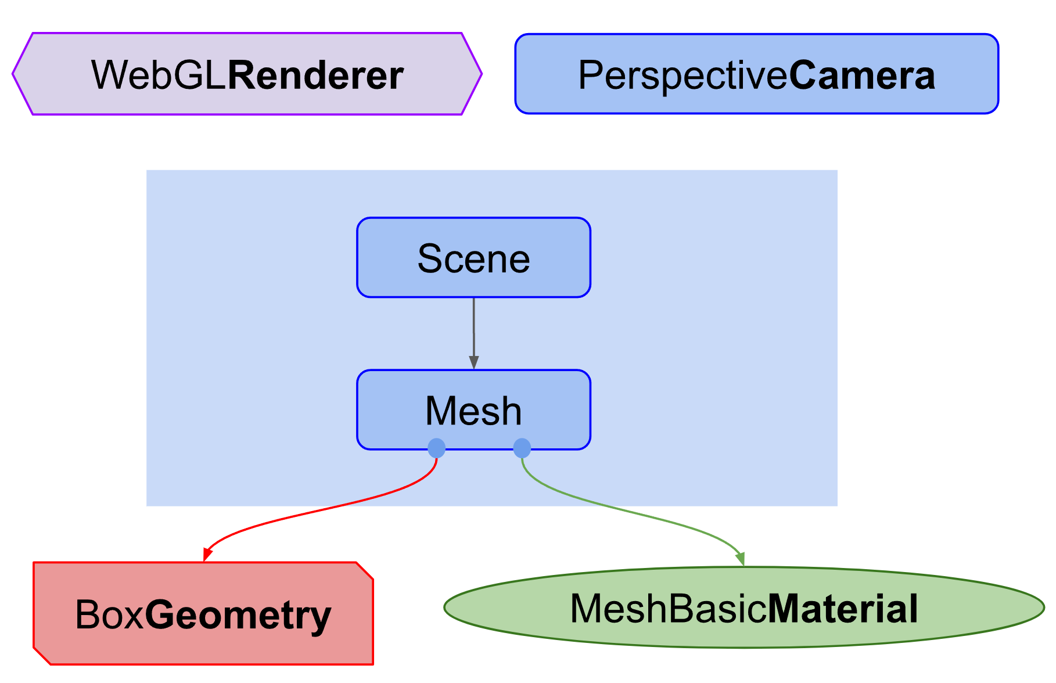
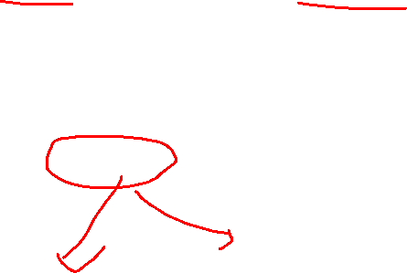
Structure of a Three.js app
The “Hello Cube” setup looks like this:
Notes:
Camera parameters:
fov is short for field of view. In this case 75 degrees in the vertical dimension. Note that most angles in three.js are in radians but for some reason the perspective camera takes degrees.
aspect is the display aspect of the canvas. We'll go over the details in another article but by default a canvas is 300x150 pixels which makes the aspect 300/150 or 2.
near and far represent the space in front of the camera that will be rendered. Anything before that range or after that range will be clipped (not drawn).
The height of the near and far planes are determined by the field of view. The width of both planes is determined by the field of view and the aspect.
Anything inside the defined frustum will be drawn. Anything outside will not.
The camera defaults to looking down the -Z axis with +Y up. We'll put our cube at the origin so we need to move the camera back a little from the origin in order to see anything.
Coordinate system:
In the diagram above we can see our camera is at z = 2. It's looking down the -Z axis. Our frustum starts 0.1 units from the front of the camera and goes to 5 units in front of the camera. Because in this diagram we are looking down, the field of view is affected by the aspect. Our canvas is twice as wide as it is tall so across the canvas the field of view will be much wider than our specified 75 degrees which is the vertical field of view.

Slide 10
Primitives

Slide 11
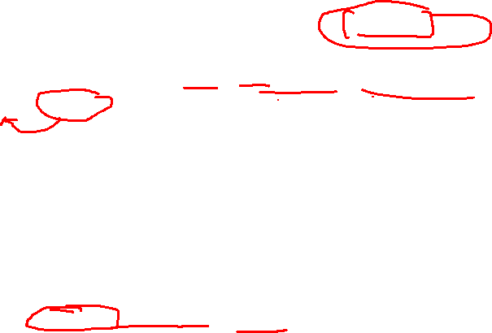
Creating a 3D object
Let’s take a look at how the cube was created!
To create a basic 3D object, we need a mesh. In three.js a mesh represents the combination of three things:
A geometry (the shape of the object)
A material (how to draw the object, what color, texture, etc.)
The position, orientation, and scale of that object in the scene relative to its parent.
Note: In the previous example, that parent is the scene.

Slide 12
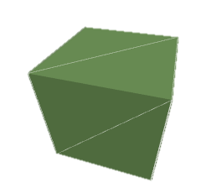
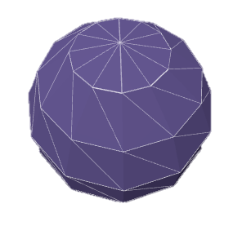
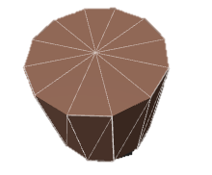
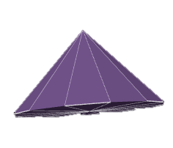
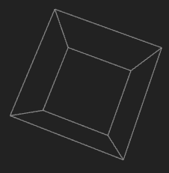
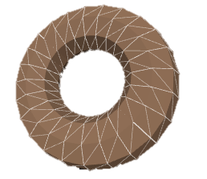
Some commonly used Primitives
Box Geometry
Sphere Geometry
Cylinder Geometry
Torus Geometry
Cone Geometry
Can you guess
what is this?
Notes:
Cho lớp ngồi 20 phút đọc code mẫu trên documentation, thực hành và gọi xung phong demo + giải thích các thuộc tính của object

Slide 13
Grouping & Hierarchy
This is almost identical to an Object3D.
Its purpose is to make working with groups of objects syntactically clearer.
// Create a group and add the two cubes.
// These cubes can now be rotated/scaled, etc., as a group.
const group = new THREE.Group();
group.add( meshA );
group.add( meshB );
scene.add( group );

Slide 14
Hands-On Activity How to draw a cat?

Slide 15

Hands-On Activity
Activity: How to draw a cat?
In this activity, you are provided with a sample picture of an orange cat.
Your tasks are:
Identify the structural characteristics of the cat (i.e., which shapes form the cat’s structure).
Implementing these shapes in Three.js
Create a function to group all these shapes and return a single object that represents the cat.

